Slide 1
Darted Cups

Slide 2
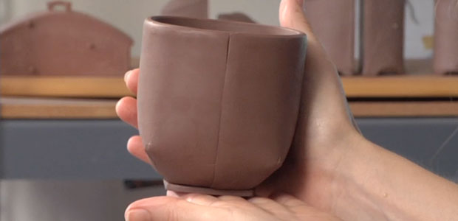
Slab method
We have just completed creating Japanese tea bowls using the pinch pot method of hand building. We also rolled out flat slabs to create textured tiles. Using the slab method once again, we will explore functional pottery with a classic form: the darted cup.

Slide 3
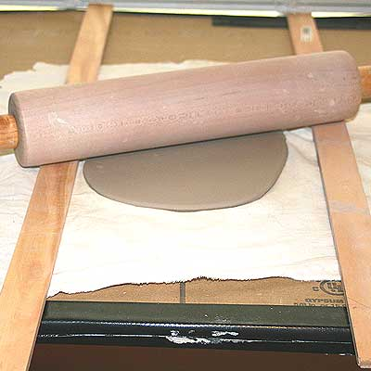
How to make a darted cup
1. Once you have a nicely wedged piece of clay, roll out a slab.

Slide 4
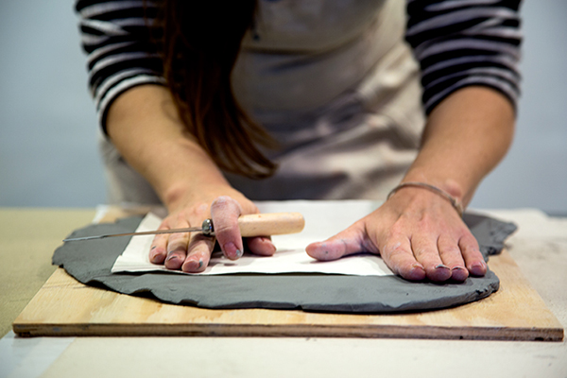
2. Using the template, cut out a rectangle.

Slide 5
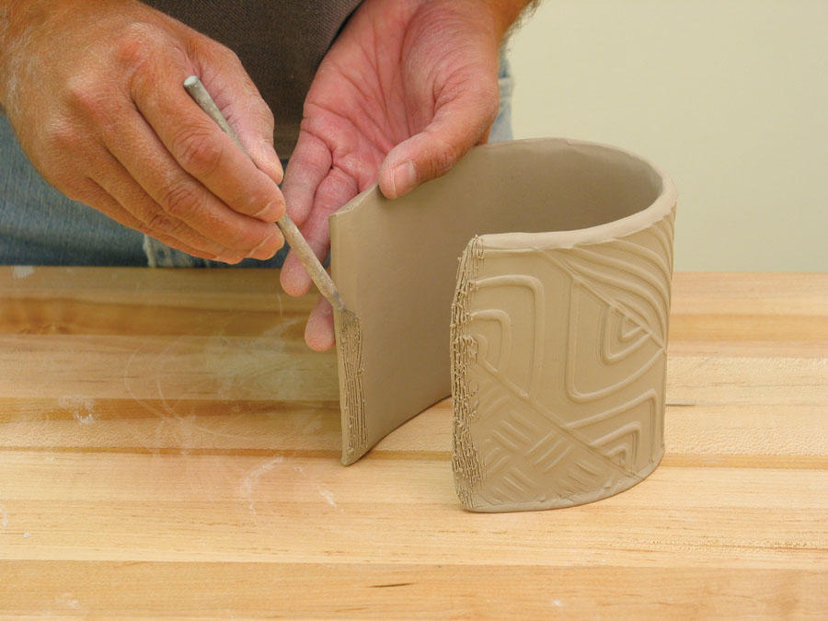
3. Score and slip the rectangle slab into a cylinder.

Slide 6
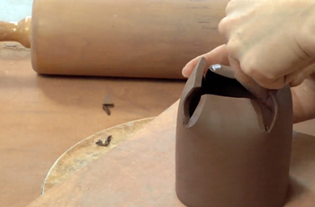
4. Here’s where it gets a little complicated… Let’s see the next steps visually!
http://ceramicartsdaily.org/pottery-making-techniques/handbuilding-techniques/how-to-slab-build-a-simple-darted-cup/

Slide 7
Once you’ve created your darted cup with the bottom and the foot, it’s time to add a handle.
https://www.youtube.com/watch?v=bFYZwjXN1EI (Simon Leach pulling hands)
https://www.youtube.com/watch?v=vNMT8s7ftYU (Simon Leach part 2, pulling off the pot
https://www.youtube.com/watch?v=NlJOvoaeTYU (How to Make Refined Handles by Combining Coiling & Pulling | BEN CARTER)
https://www.youtube.com/watch?v=n9Q9y1O7CgI (Handles three ways)

Slide 8
Underglazes and Pattern
For this project, we will be focussing on the principle of pattern.
Pattern refers to the repetition or reoccurrence of a design element, exact or varied, which establishes a visual beat.
Using underglazes, you will create a pattern on your darted cup.
Consider colour schemes in your design and keep your repeated pattern simple, clean and graphic. You may use the pattern you created in the previous semester.
The cup will then be bisque fired, after which you will need a clear glaze on top to seal your design and make it food safe.

Slide 9
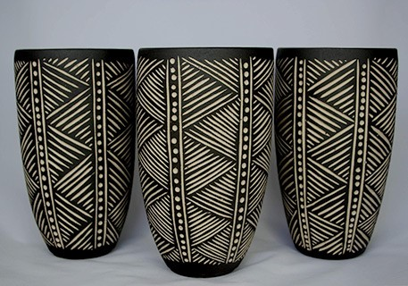
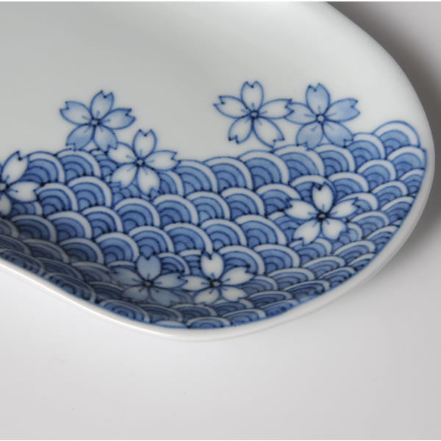

Slide 10
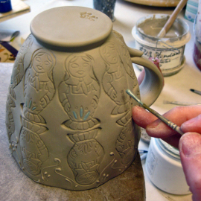
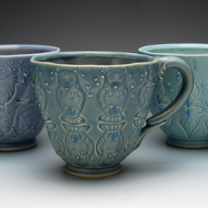

Slide 11
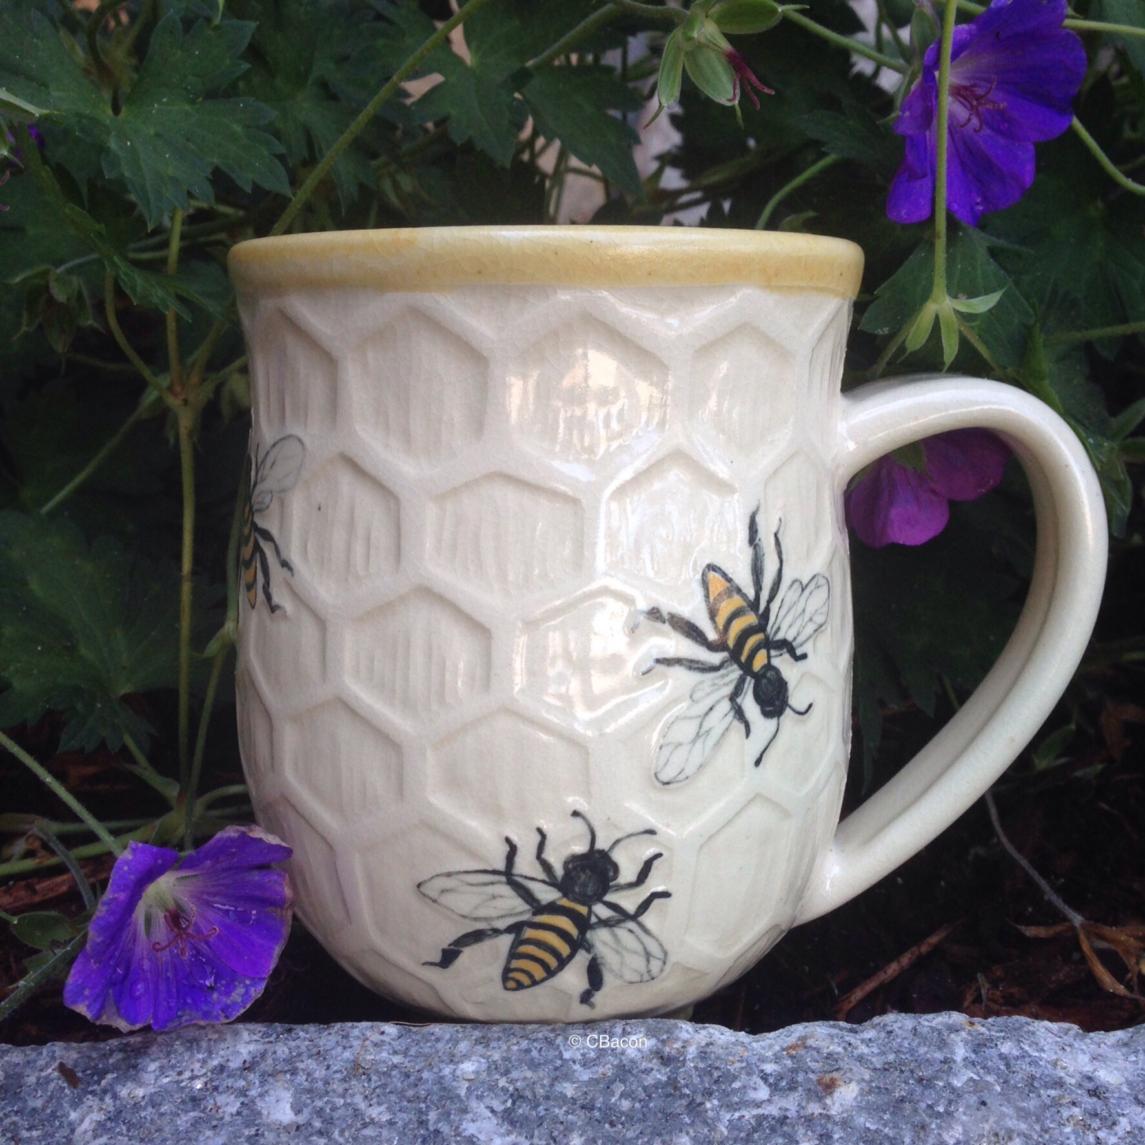
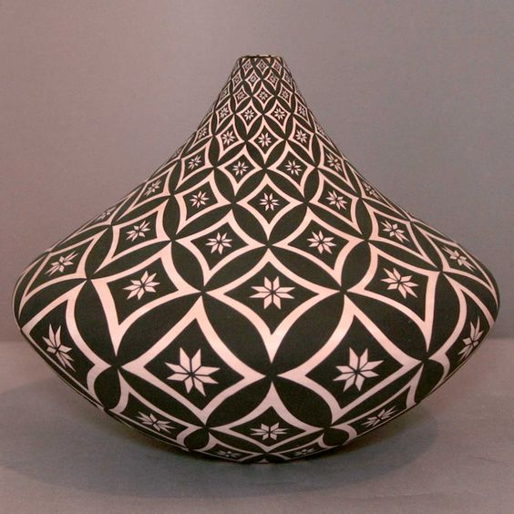

Slide 12
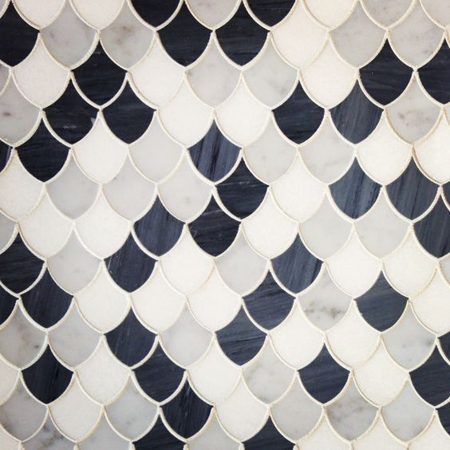
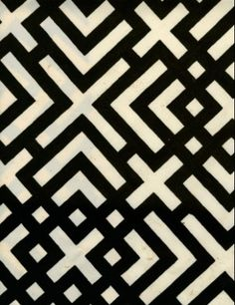

Slide 13
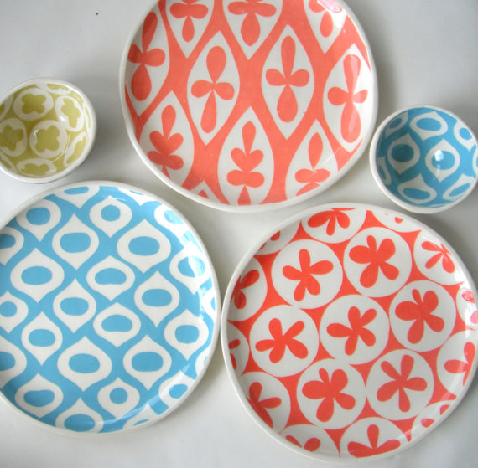

Slide 14
Once again….
You are creating:
a darted cup,
with a base and a foot,
a handle,
decorated in underglazes in a repeat pattern.

